Slide 1
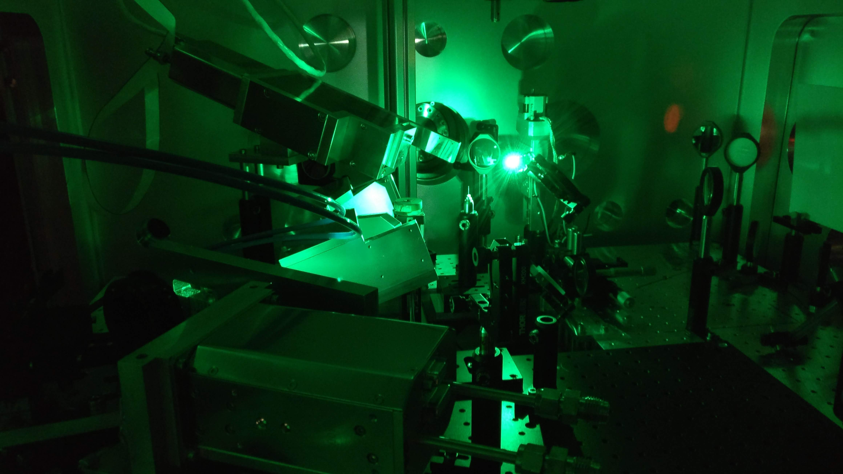
Soft X-Ray Spectrometers for Absorption Spectroscopy of Aluminum in Laser Driven Backlighter Experiments
Master’s Thesis Presentation by Carlos Butler
Department of Plasma Physics/PHELIX at GSI

Slide 2
Motivation
Spectrometer Design
Experiment
Outlook
Results and Discussion

Slide 3
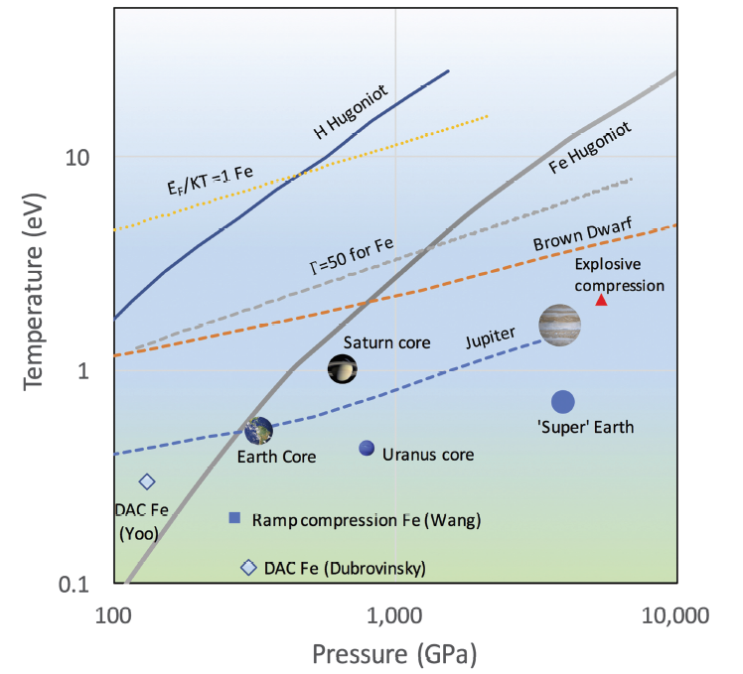
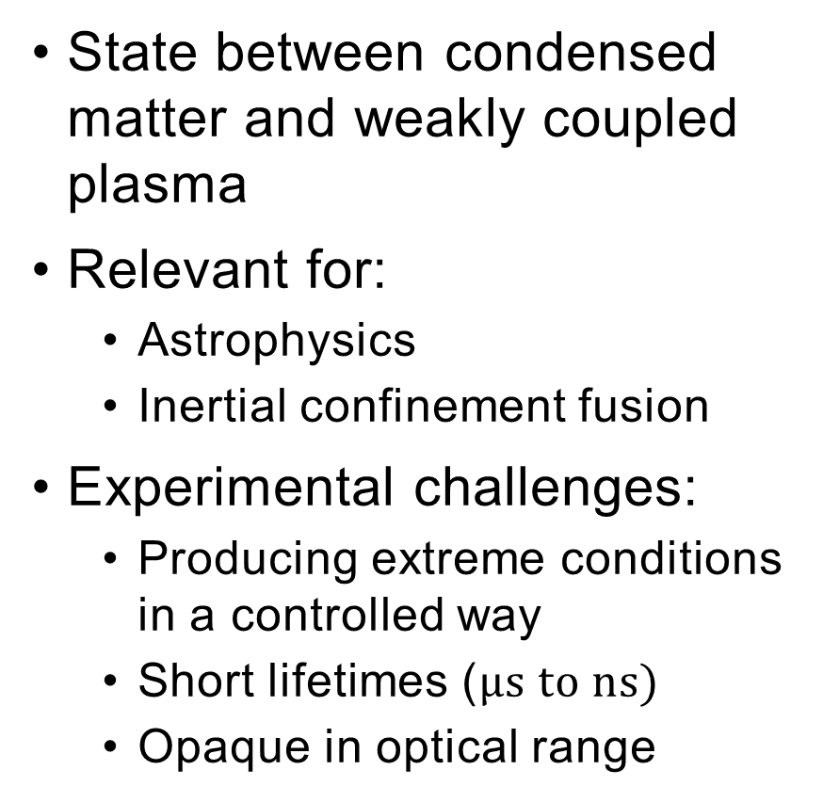
Warm Dense Matter (WDM)
State between condensed matter and weakly coupled plasma
Relevant for:
Astrophysics
Inertial confinement fusion
Experimental challenges:
Producing extreme conditions in a controlled way
Short lifetimes ($μs to ns)$
Opaque in optical range
Riley D., Plasma Phys. Control. Fusion 60, 2018
Notes:
WDM at or above solid density
One by one

Slide 4
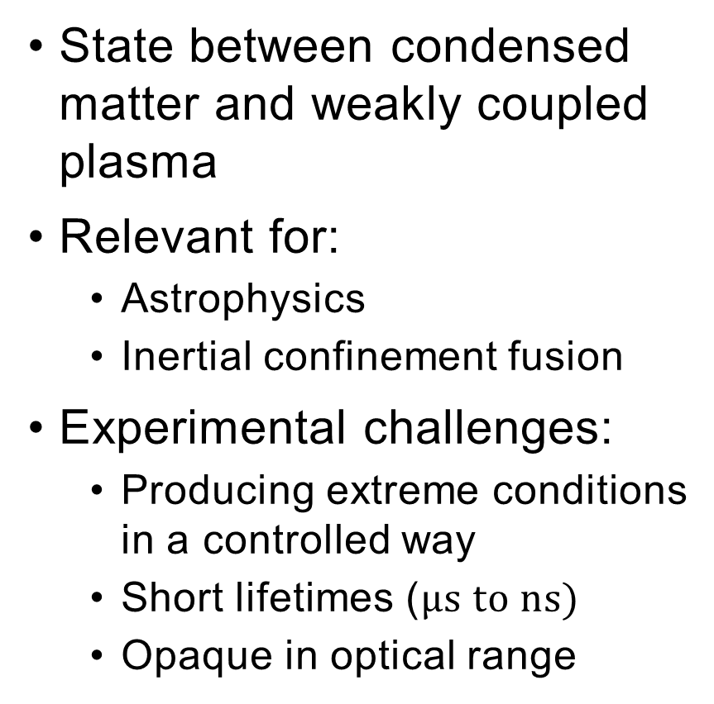
Warm Dense Matter (WDM)
State between condensed matter and weakly coupled plasma
Relevant for:
Astrophysics
Inertial confinement fusion
Experimental challenges:
Producing extreme conditions in a controlled way
Short lifetimes ($μs to ns)$
Opaque in optical range
Dump energy in short time and small volume
X-rays for diagnostics
Riley D., Plasma Phys. Control. Fusion 60, 2018

Slide 5
Experimental Scheme
Unique pump-probe scheme at FAIR:
Heavy-ion beam for WDM generation
Laser-plasma as x-ray source
Homogeneous WDM sample with fast, tunable x-ray source
Measuring
Device
Reference
X-rays
Backlighter
Target
Plasma
Intense Laser
Diagnostic? → X-ray Absorption Fine-structure Spectroscopy (XAFS)
WDM
Sample
Transmitted
X-rays
Heavy-ion
Beam
Measuring
Device

Slide 6
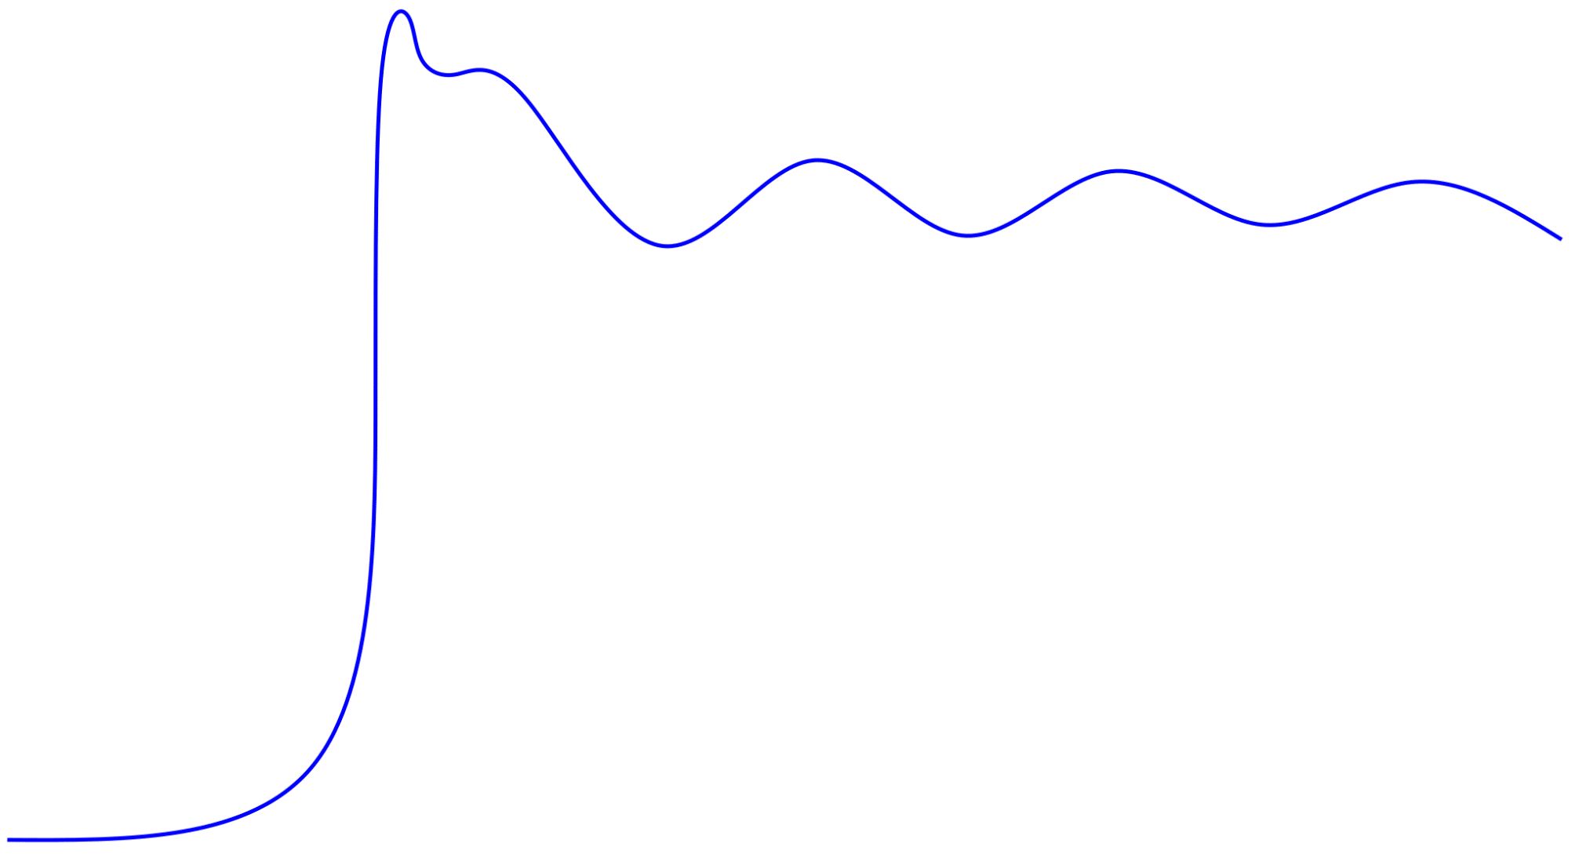
X-Ray Absorption Fine-Structure (XAFS)
Source
X-rays
Spectrometers
Source
Transmitted
Al Sample
Transmitted x-rays
Studies structures around edge (rapid rise) in absorption spectrum
For WDM, can extract:
Density
Temperature
Ionic order
Ionization
Absorption Coefficient
Photon Energy
Notes:
A mature method used in numerous fields (biology, solid-state physics, since 1988 WDM research
Edge is jump in absorption at ionization energy of a shell

Slide 7
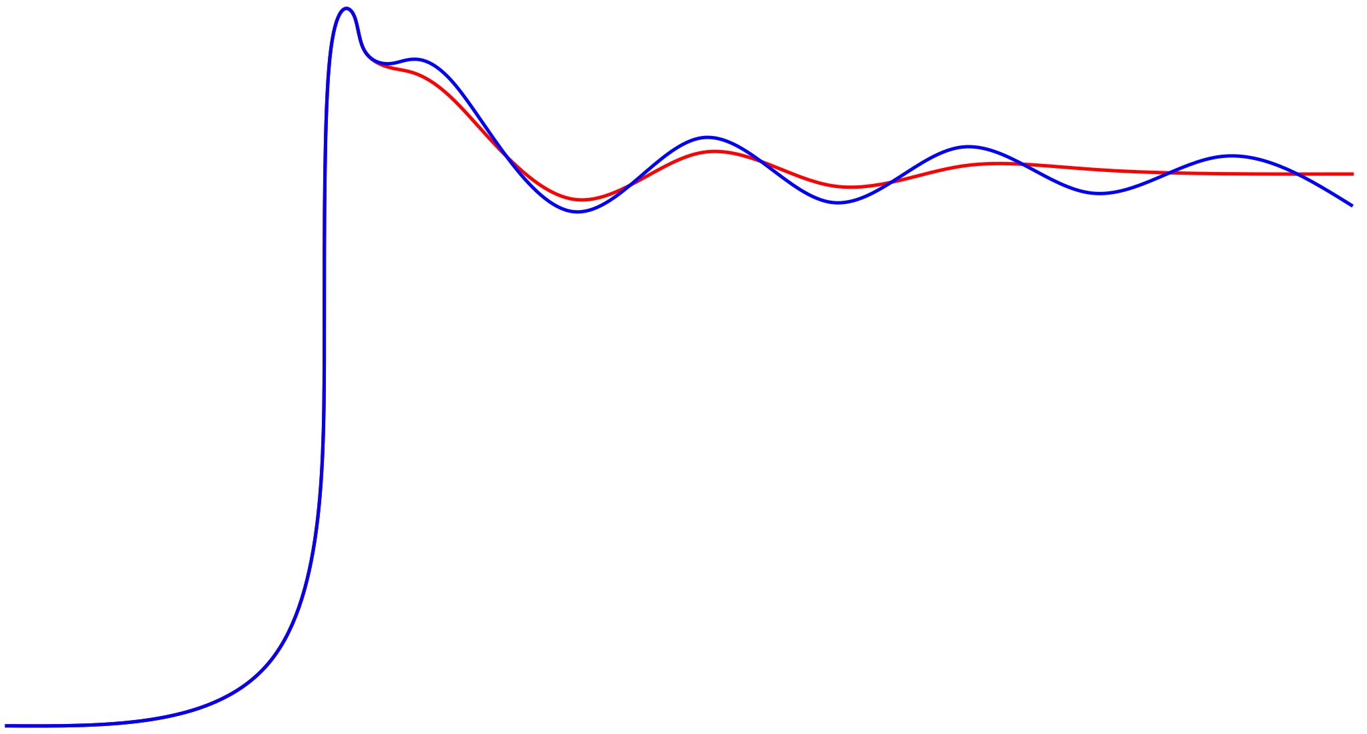
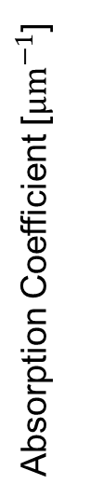
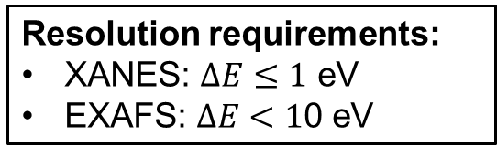
XAFS Example for Aluminum
2
Extended X-ray Absorption Fine-Structure (EXAFS)
X-ray Absorption Near Edge Structure (XANES)
High T Low T
Absorption Coefficient [$μm^{−1}$]
For example:
Amplitude of oscillations → temperature
Resolution requirements:
XANES: $ΔE≤1$ eV
EXAFS: $ΔE<1$0 eV
0.1
1560
1600
Photon Energy [eV]
1700

Slide 8
Overview
Overarching project: Probe WDM of aluminum with x-rays from laser-plasma backlighters using XAFS
Requirement: Specialized spectrometers
X-ray Spectrometer
Measuring
Device
Backlighter
Target
PHELIX
Intense Laser
Thesis goal: Design and test x-ray spectrometers
Aluminium
Sample
Sample
X-ray Spectrometer
Measuring
Device
Heavy-ion
Beam

Slide 9
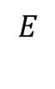
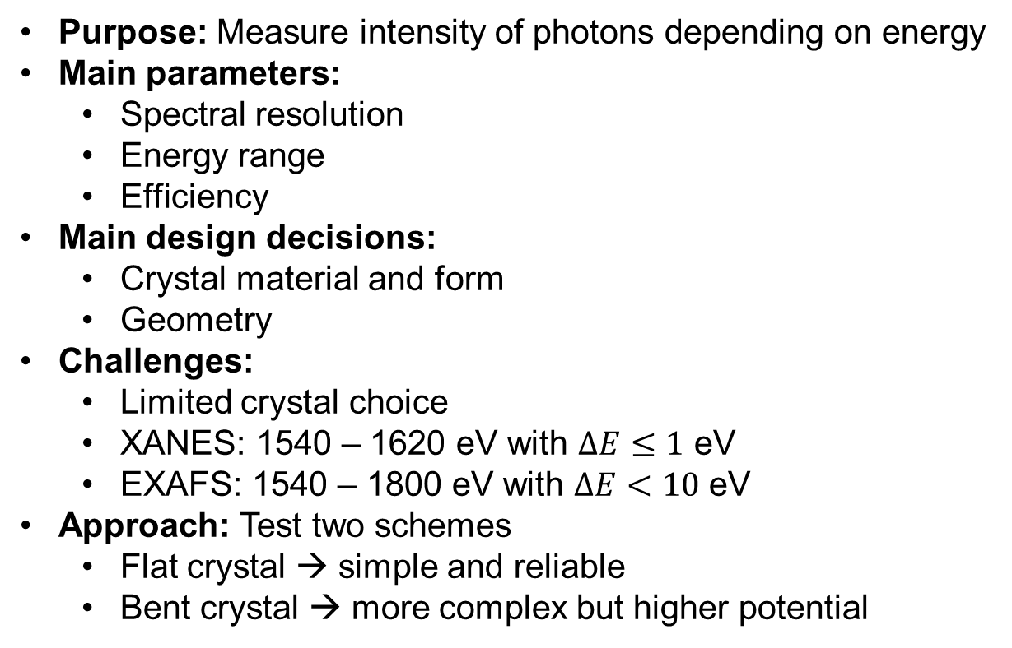
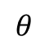
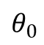
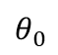
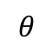
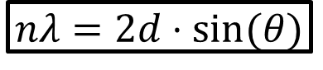
Fundamentals of X-Ray Spectrometers
Purpose: Measure intensity of photons depending on energy
Main parameters:
Spectral resolution
Energy range
Efficiency
Main design decisions:
Crystal material and form
Geometry
Challenges:
Limited crystal choice
XANES: 1540 – 1620 eV with $ΔE≤1$ eV
EXAFS: 1540 – 1800 eV with $ΔE<10$ eV
Approach: Test two schemes
Flat crystal → simple and reliable
Bent crystal → more complex but higher potential
$$E$$
X-ray Source
Detector
$$θ$$
$$θ$$
$$θ_{0}$$
$$θ_{0}$$
$$nλ=2d⋅sin⁡(θ)$$
Crystal
Notes:
Focus on challenges of setup and creating the spectrometer due to restrictions, rather than design philosphies
Spectral resolution: the lower the better

Slide 10

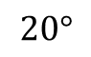

Flat-crystal Spectrometer
Dual Unbent Crystal speCtrometer (DUCC)
Top view:
ADP Crystal
Side view:
Backlighter
Target
Laser Beam
Backlighter
Target
$$20°$$
Sample
Detector
Laser Beam
ADP Crystal
Sample
Detector
From simulation:
Energy range of 1540 – 1620 eV
Resolution of 0.7 eV
$$E_{s}$$
$$E_{t}$$
Ion beam
(Future Experiment)
ADP Crystal
View on Detector
Suited to XANES!

Slide 11
Bent-crystal Spectrometer
Focusing Spectrograph with Spatial Resolution in 1-D (FSSR-1D)
Mica crystal
Spherically-bent crystal → works similarly to a convex mirror
Spectral focusing in dispersive plane
1-D imaging in vertical plane
Rowland Circle
Vertical
Source
Dispersive
On detector
From simulation:
Energy range of 1465 – 1755 eV
Resolution of 0.56 eV
Detector
Vertical
Dispersive
Suited to EXAFS!
Source

Slide 12
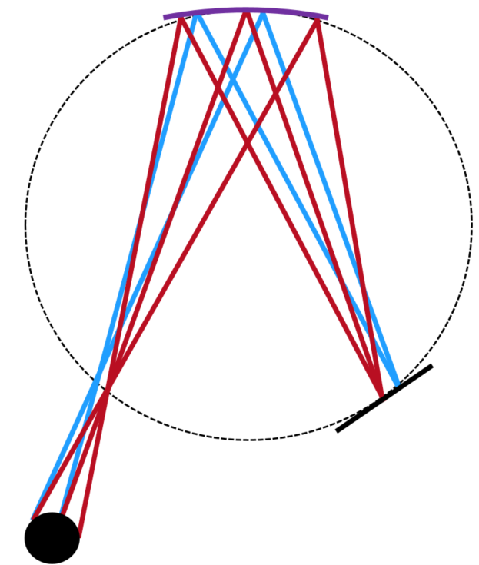
Comparison
DUCC
FSSR
Flat crystal → simple, robust geometry
ADP crystal → good crystal properties
Dual channel → absorption spectra with one spectrometer
Spherically-bent crystal → high intensity and resolution
Mica crystal → common in literature
1-D imaging → good signal-to-noise ratio
Spectrometer | Regime | Energy Range | Resolution
DUCC | XANES | 1540 – 1620 eV | 0.7 eV
FSSR | EXAFS | 1465 – 1755 eV | 0.56 eV

Slide 13
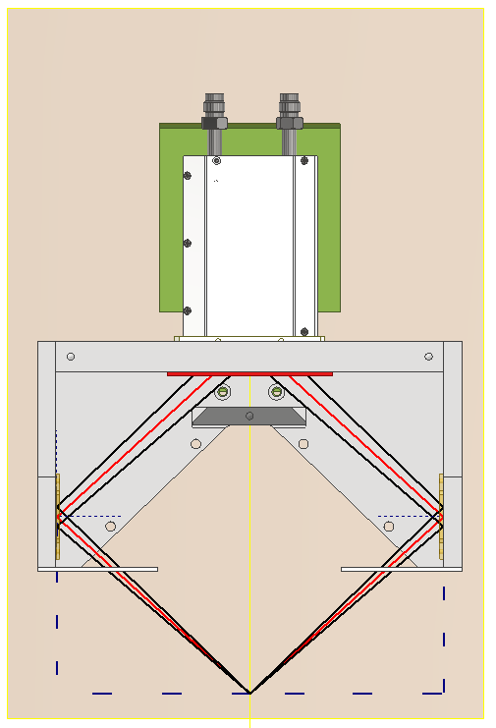

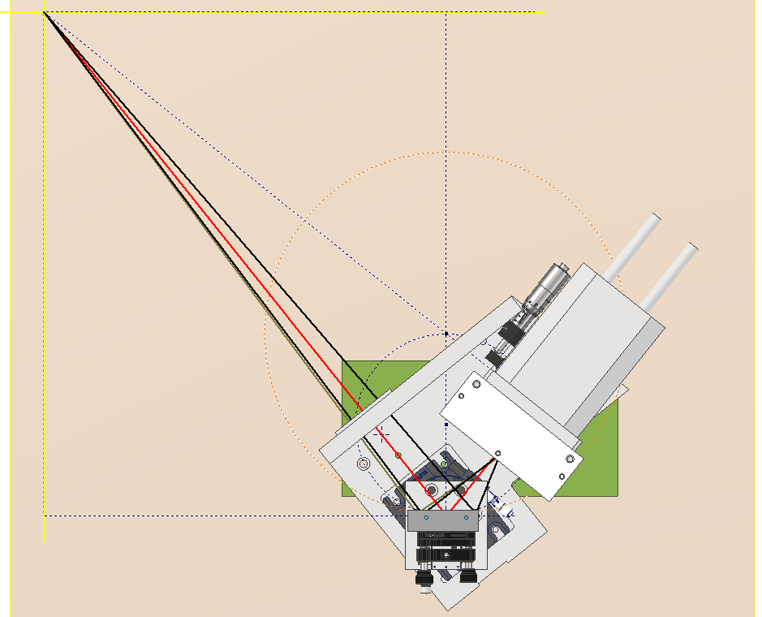
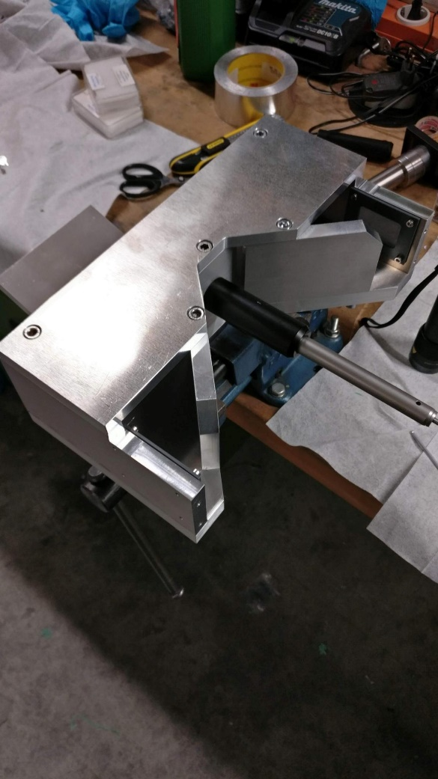
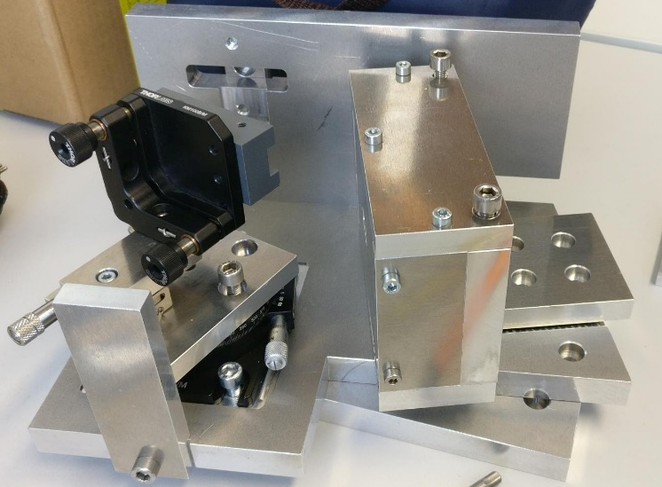
Fabrication
DUCC: Flat crystal design
FSSR: Bent crystal design

Slide 14
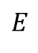
Experimental Setup
X-Ray
Camera
Two additional spectrometers by P. Hesselbach: Single Unbent Crystal speCtrometer (SUCC) and Old SUCC (OSUCC)
Flat-crystal geometry with KAP crystal
Energy range of 1400 – 1800 eV
SUCC for control spectra
OSUCC for transmitted spectra (can replace FSSR)
SUCC
Spectrometer
Backlighter
X-Ray
Camera
PHELIX
DUCC Spectrometer
Al Sample
Three backlighter materials:
Rare-earths: Intense emission but with structure
Teflon: Weaker emission but smooth spectrum
Aluminum: For spectrometer characterization
Goal: Find spectrometer + backlighter combination that yields smooth, high resolution absorption spectra
$$E$$
FSSR-1D
Spectrometer
X-Ray
Camera
KAP Crystal

Slide 15
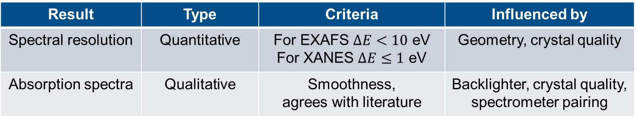
Data Processing
Use self-developed python program: Analysis of X-ray Absorption for WDM Observation and Testing of Locally-made Spectrometers (AXAWOTLS)
Quick processing of raw images to spectra and analysis during beamtimes
Adaptable to any spectrometer
Study two sets of results:
Result | Type | Criteria | Influenced by
Spectral resolution | Quantitative | For EXAFS $ΔE<10$ eV For XANES $ΔE≤1$ eV | Geometry, crystal quality
Absorption spectra | Qualitative | Smoothness, agrees with literature | Backlighter, crystal quality, spectrometer pairing

Slide 16
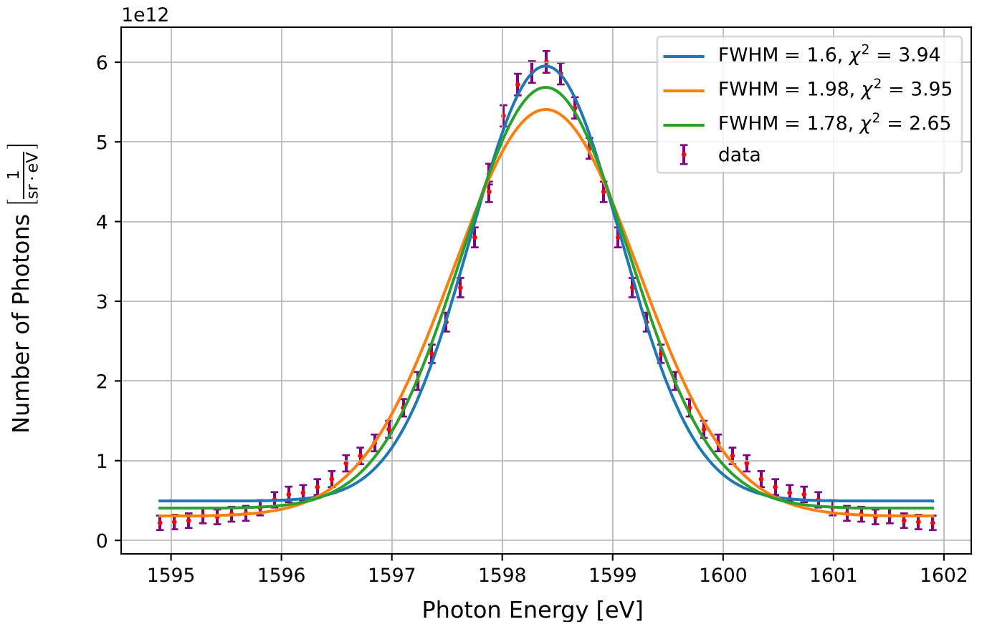
Spectral Resolution
Gaussian Fit of the He-α emission line of aluminum backlighter
Deconvolve FWHM and Doppler broadening → spectral resolution

Slide 17
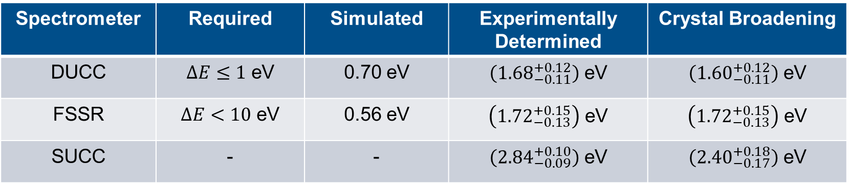
Spectral Resolution
Gaussian Fit of the He-α emission line of aluminum backlighter
Deconvolve FWHM and Doppler broadening → spectral resolution
DUCC’s resolution insufficient for XANES
FSSR and SUCC sufficient for EXAFS
Main Contribution: Crystal broadening → Crystal quality is limiting factor
Spectrometer | Required | Simulated | Experimentally Determined | Crystal Broadening
DUCC | $ΔE≤1$ eV | 0.70 eV | $\left({1.68}_{−0.11}^{+0.12}\right)$ eV | $\left({1.60}_{−0.11}^{+0.12}\right)$ eV
FSSR | $ΔE<10$ eV | 0.56 eV | $\left({1.72}_{−0.13}^{+0.15}\right)$ eV | $\left({1.72}_{−0.13}^{+0.15}\right)$ eV
SUCC | - | - | $\left({2.84}_{−0.09}^{+0.10}\right)$ eV | $\left({2.40}_{−0.17}^{+0.18}\right)$ eV

Slide 18
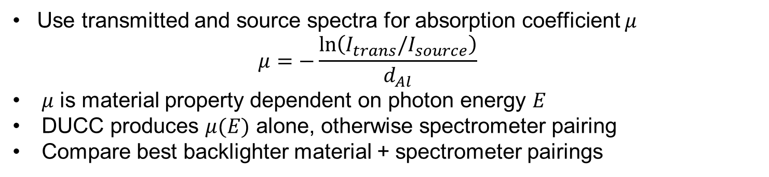
Absorption Spectra
Use transmitted and source spectra for absorption coefficient $μ$
$$μ=−\frac{\ln\left(I_{trans}/I_{source}\right)}{d_{Al}}$$
$μ$ is material property dependent on photon energy $E$
DUCC produces $μ(E)$ alone, otherwise spectrometer pairing
Compare best backlighter material + spectrometer pairings
Source
Trans-mitted

Slide 19
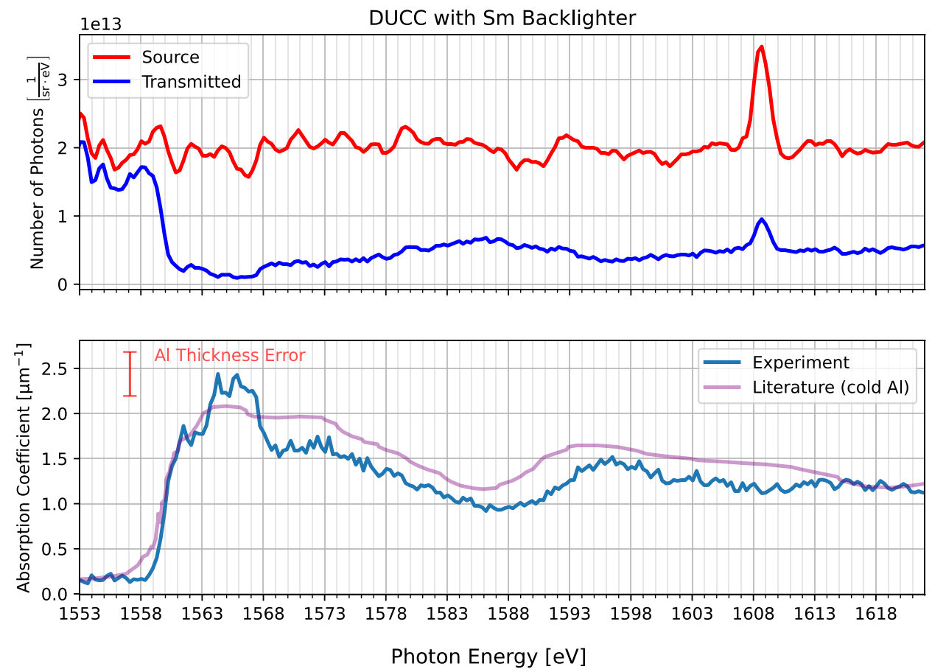

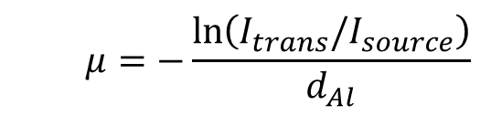
Absorption Spectra
$$μ=−\frac{\ln\left(I_{trans}/I_{source}\right)}{d_{Al}}$$
Spectrometers | Backlighter | Quality
DUCC | Rare-earth
OSUCC/SUCC | Teflon
FSSR/SUCC | Teflon
DUCC
DUCC
Notes:
Explain why the combinations are chosen in more detail

Slide 20
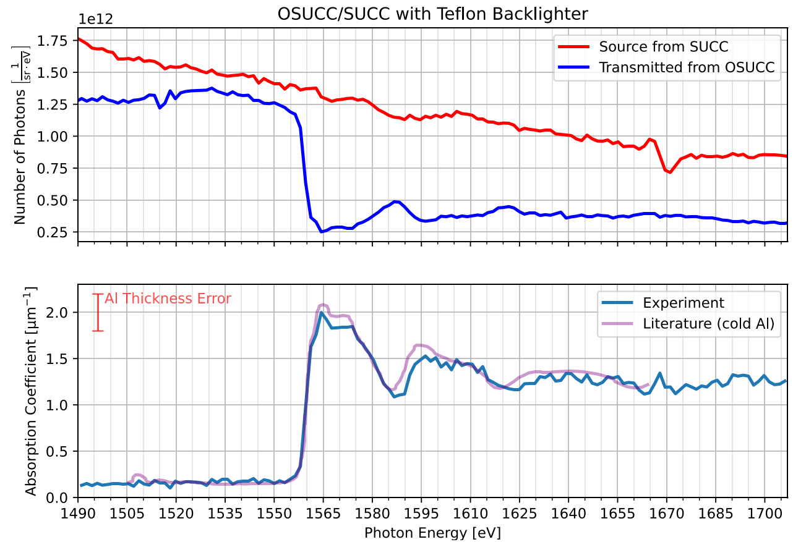
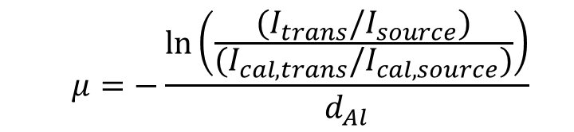
Absorption Spectra
$$μ=−\frac{\ln\left(\frac{{(I}_{trans}/I_{source})}{{(I}_{cal,trans}/I_{cal,source})}\right)}{d_{Al}}$$
Spectrometers | Backlighter | Quality
DUCC | Rare-earth
OSUCC/SUCC | Teflon
FSSR/SUCC | Teflon
SUCC
OSUCC

Slide 21
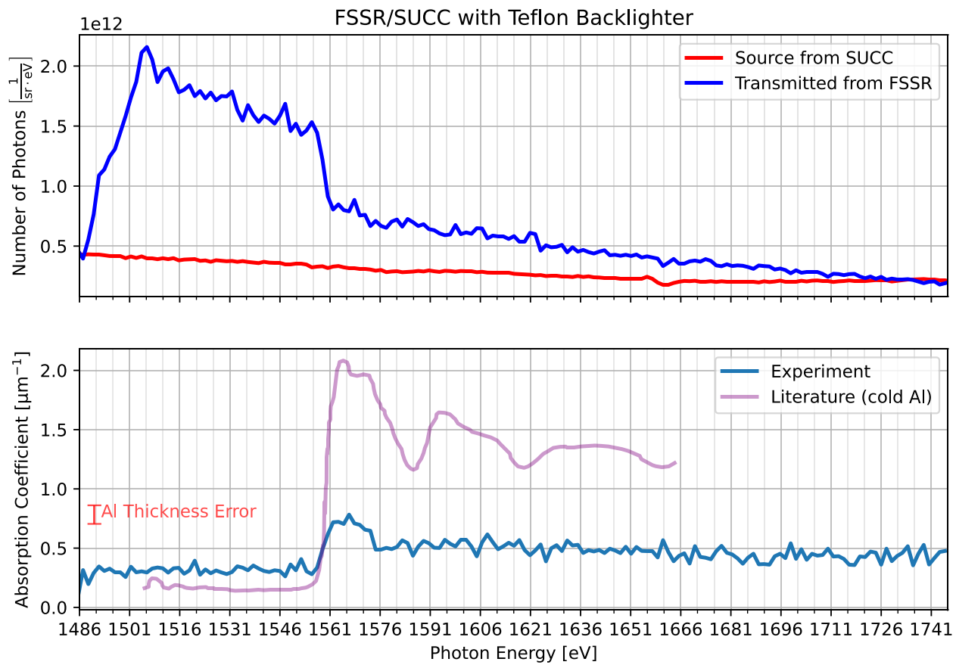
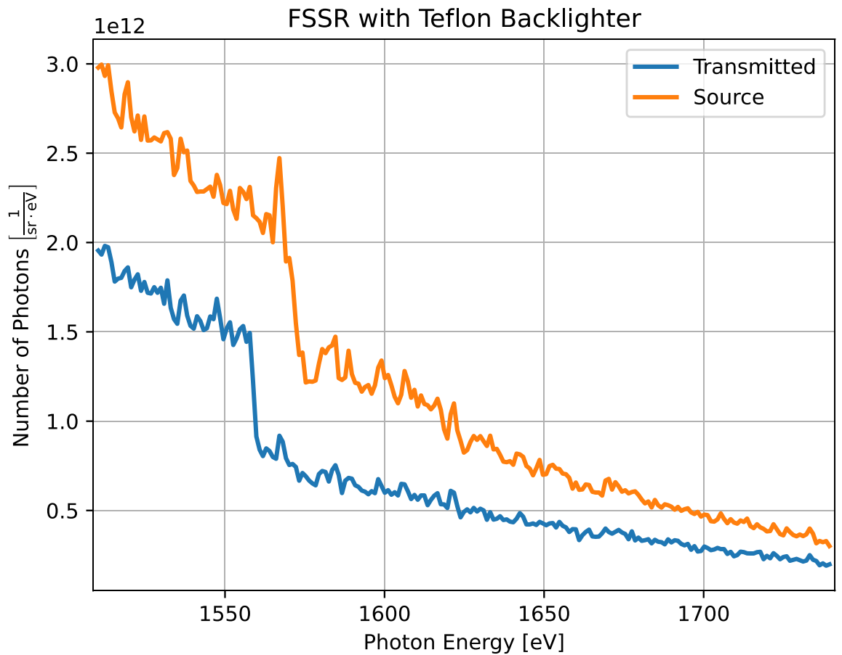
Absorption Spectra
$$μ=−\frac{\ln\left(\frac{{(I}_{trans}/I_{source})}{{(I}_{cal,trans}/I_{cal,source})}\right)}{d_{Al}}$$
Spectrometers | Backlighter | Quality
DUCC | Rare-earth
OSUCC/SUCC | Teflon
FSSR/SUCC | Teflon
X
SUCC
FSSR

Slide 22
Summary
Thesis goal: Design and test x-ray spectrometers for XAFS of aluminum to use in WDM research with heavy-ion beam sample heating and laser-plasma backlighters
Tested two schemes:
Flat crystal → DUCC with ADP crystal (simple, dual channel)
Bent crystal → FSSR with mica crystal (complex, focusing)
Additionally in experiment: SUCC and OSUCC with KAP crystal
Results:
DUCC:
+ Dual channel design effective for absorption spectra
­­– Insufficient resolution (1.68 eV > 1 eV)
FSSR:
+ High resolution (1.72 eV << 10 eV)
­­– Absorption edge in mica crystal → poor absorption spectra
SUCC:
+ Good resolution (2.84 eV << 10 eV)
­­+ Excellent absorption spectra with OSUCC/SUCC

Slide 23
Outlook
Crystal quality significant to resolution → characterize crystals before finalizing design!
DUCC has potential if crystal quality ensured
FSSR is powerful, but adds complexity and requires a different crystal
From SUCC, design with flat KAP crystal and Teflon backlighter effective for EXAFS
Dual channel layout leads to high quality absorption spectra
DUCC and FSSR have potential for future experiments!
Next spectrometer: Dual channel geometry with KAP crystals and Teflon backlighter!
High quality EXAFS in heavy-ion beam + PHELIX laser experiment of 2024

Slide 24

Next spectrometer: Dual channel geometry with KAP crystals and Teflon backlighter!
High quality EXAFS in heavy-ion beam + PHELIX laser experiment of 2024
Thanks for your attention!

Slide 25
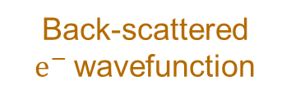
X-Ray Absorption Fine-Structure (XAFS)
Source
Sample
Spectrometer
X-rays
Transmitted x-rays
Studies structures around edge (rapid rise) in absorption spectrum
Structures caused by quantum scattering
Photoelectron wavefunction
Atoms in lattice
For WDM, can extract:
Density
Temperature
Ionic order
Ionization
X-ray
Back-scattered $e^{−}$wavefunction
Notes:
A mature method used in numerous fields (biology, solid-state physics, since 1988 WDM research
Edge is jump in absorption at ionization energy of a shell
Process in diagram happens in sample (point out)
XAFS: 1) x-ray photoionizes electron from absorbing atom
2) photoelectron quantum mechanically scatters on neighboring electron
3) part of wavefunction reflected back to absorbing atom
4) Backscattered wavefunction modulates electronic state at first atom
5) absorption coefficient dependent on electronic state → modulates mu as well → structures dependent on lattice and structure
IMPORTANT: all happens in a single coherent quantum state at absorbing atom → all absorption events effected!
Next will see example of an absorption spectrum

Slide 26
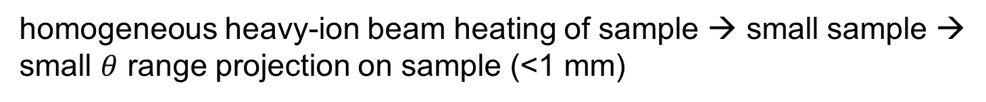
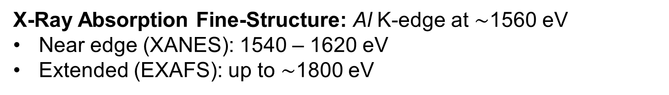
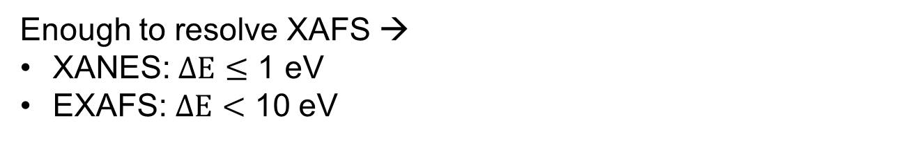
Considerations
X-Ray Absorption Fine-Structure: Al K-edge at $∼$1560 eV
Near edge (XANES): 1540 – 1620 eV
Extended (EXAFS): up to $∼$1800 eV
Energy Range
Sample Size
Resolution
Intensity
Physical Size
homogeneous heavy-ion beam heating of sample → small sample → small $θ$ range projection on sample (<1 mm)
Enough to resolve XAFS →
XANES: $ΔE≤$ 1 eV
EXAFS: $ΔE<$ 10 eV
High as possible without saturation
Fit in HHT chamber → length < 550 mm

Slide 27
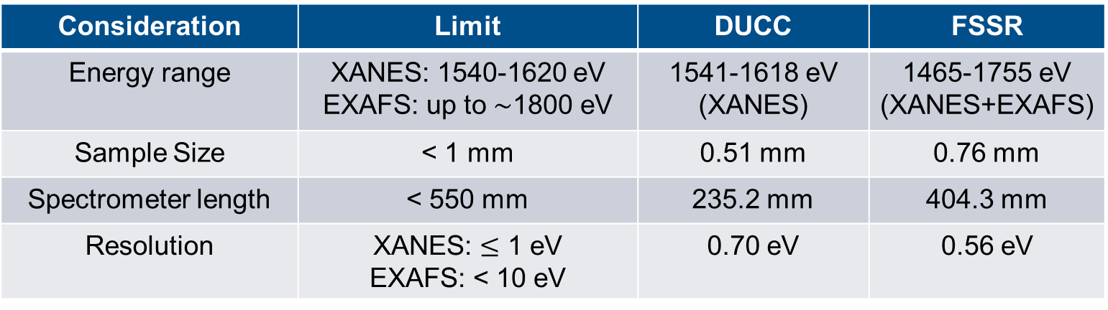
Consideration | Limit | DUCC | FSSR
Energy range | XANES: 1540-1620 eV EXAFS: up to $∼$1800 eV | 1541-1618 eV (XANES) | 1465-1755 eV (XANES+EXAFS)
Sample Size | < 1 mm | 0.51 mm | 0.76 mm
Spectrometer length | < 550 mm | 235.2 mm | 404.3 mm
Resolution | XANES: $≤$ 1 eV EXAFS: < 10 eV | 0.70 eV | 0.56 eV

Slide 28
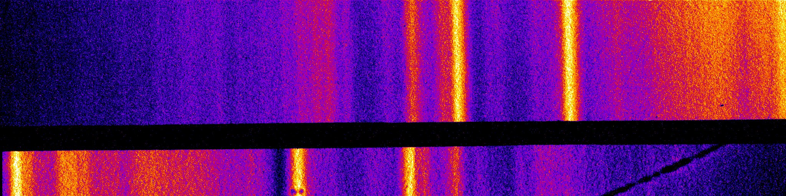
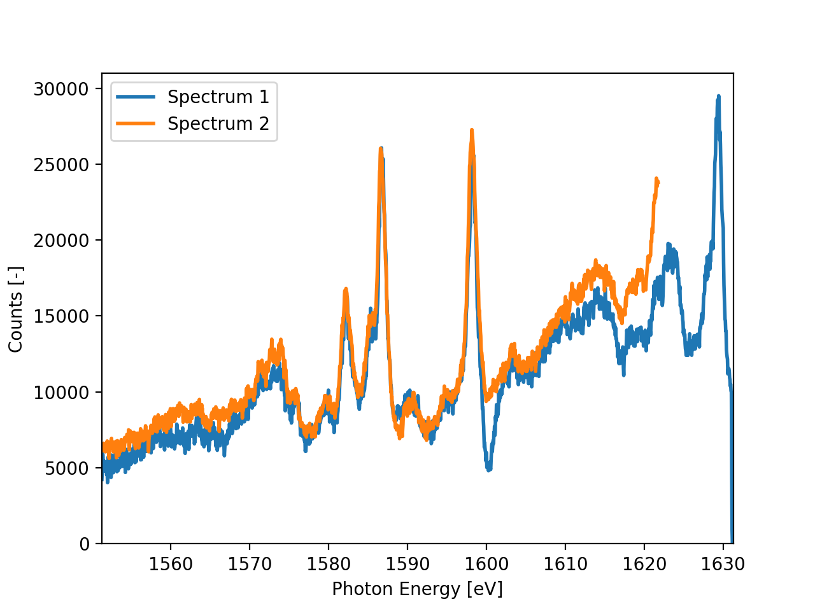
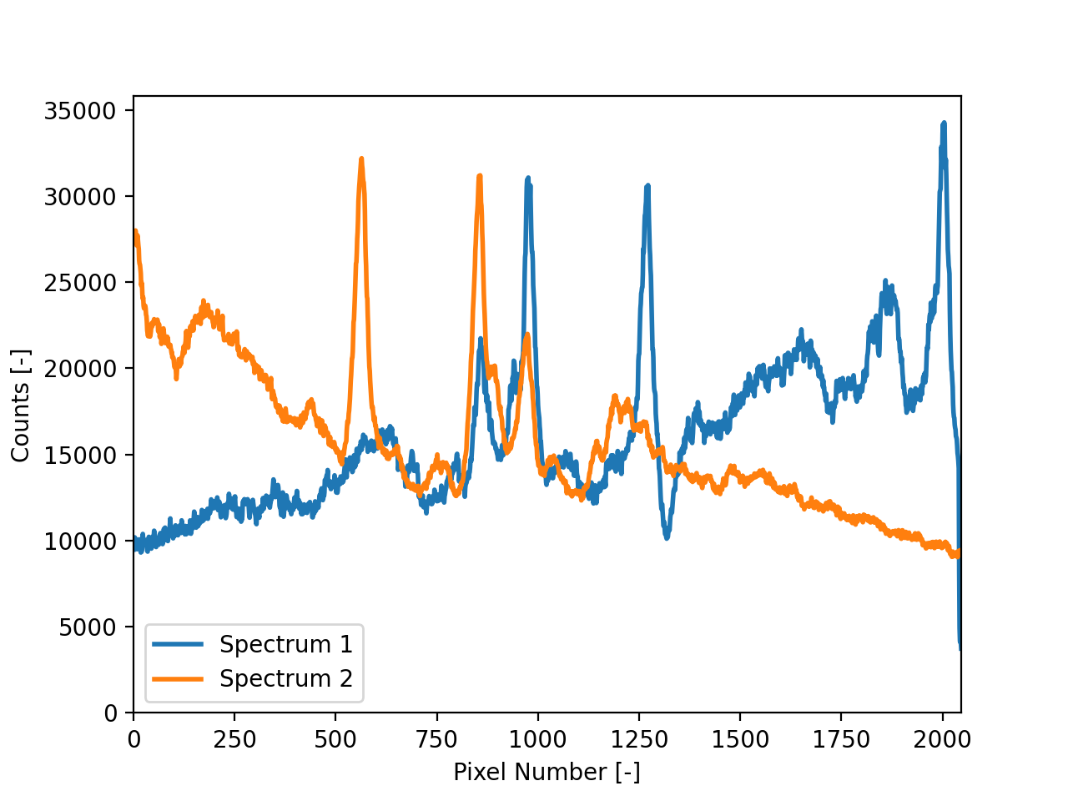
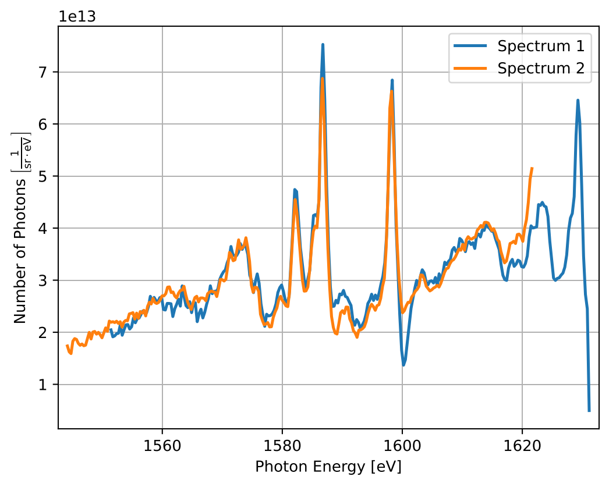
Dispersion
Spectrum 1
Background
Spectrum 2
Correct out filters, camera effects, and geometry, then bin the data
Take line outs of each section
Flip spectra if needed, correct background, and convert pixel number to photon energy

Slide 29
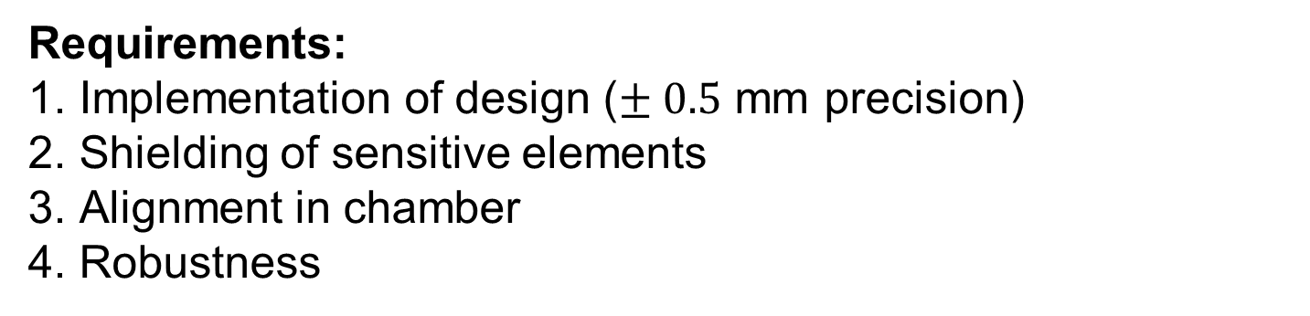
Components and Requirements
Requirements:
Implementation of design ($± 0.5$ mm precision)
Shielding of sensitive elements
Alignment in chamber
Robustness
Main Components | Purpose
Greateyes x-ray camera | Record spectra
Aluminum housing | Structure and shielding
Carbon filters | Insulation of camera chip
Mylar (plastic) filters | Shielding of crystals
Alignment apparatus | Alignment

Slide 30
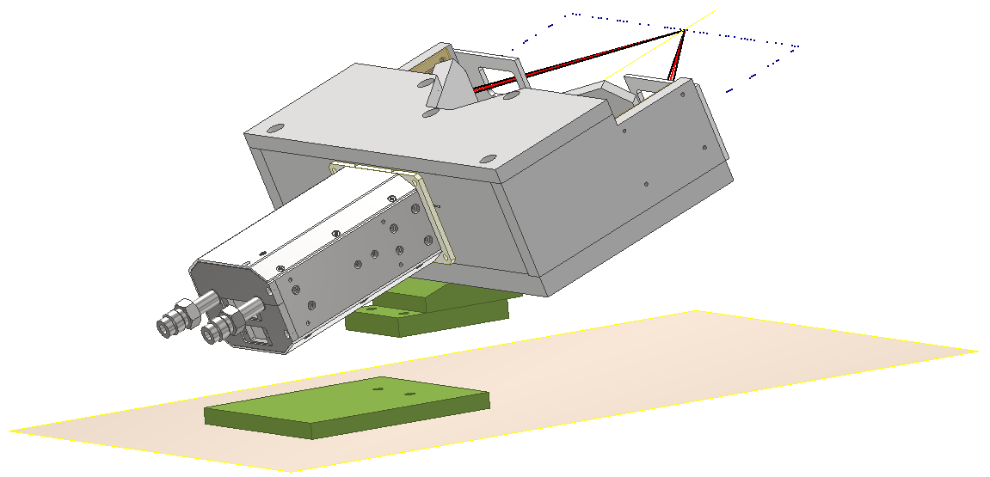
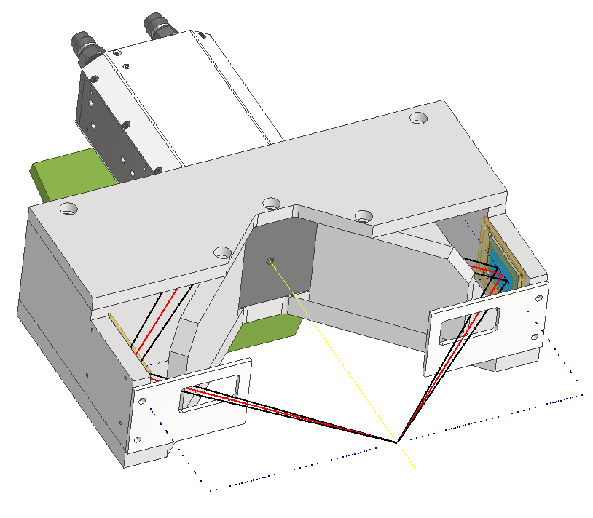
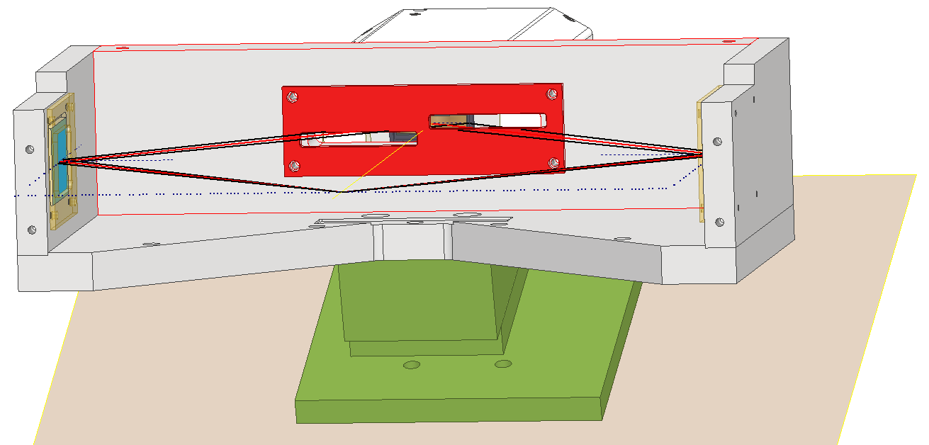
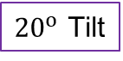
DUCC
Back
Scheme
Camera
${20}^{o}$ Tilt
Top
Front/Side
Front
Pointer Holder
Carbon Filter Holder
Blast Shields

Slide 31
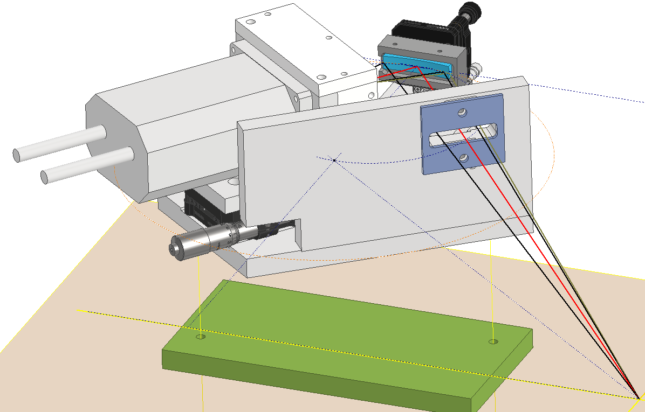
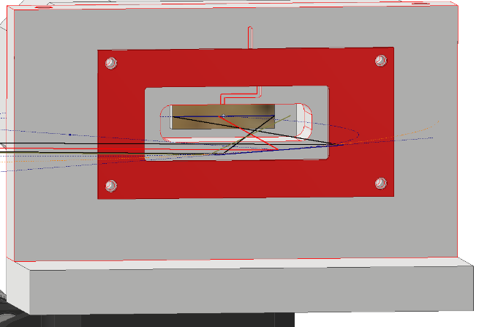
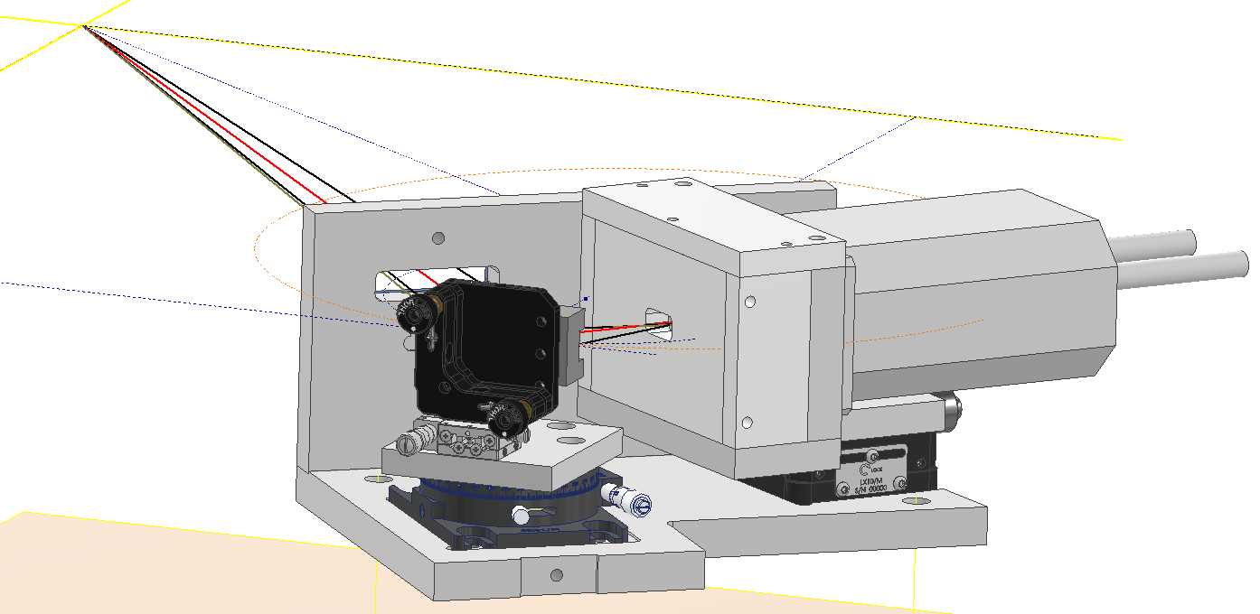
FSSR
Scheme
Front
Crystal
Blast Shield
Inside Snout
Main Shielding
Top
Back
Carbon Filter Holder
Snout
Stages for Alignment

Slide 32
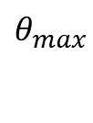



Sample Size Consideration
Source
$$1 mm$$
$nλ=2d_{ℓ}\sin\left(θ\right)$ → $λ∝\sin\left(θ\right)$
→ $\frac{dλ}{dθ}∝cos⁡(θ)$
Sample
Ion beam
(Future Experiment)
$$θ_{max}$$
$$θ_{min}$$
Crystal

